Slide 1

INT253: WEB DEVELOPMENT IN PYTHON USING DJANGO
L:2 T:0 P:2
Credits:3

Slide 2
Course Outcomes
CO1 :: understand Python/Django installation, editor setup, project creation, grasp Django commands, and excel in app structuring
CO2 :: experiment views, map URLs for content display, handle HTTP methods, and manage errors for enhanced functionality
CO3 :: apply Django templates for creation, variable handling, loops, conditions, inheritance, debugging, and app testing
CO4 :: apply Django forms for handling GET, POST, HTTP, implementing CSRF security, and validating data
CO5 :: apply Django for modeling, migrations, ORM, Admin, user management, and database setup
CO6 :: apply techniques for cookies, sessions, user management, login/logout URLs, and view-based login within the system.

Slide 3
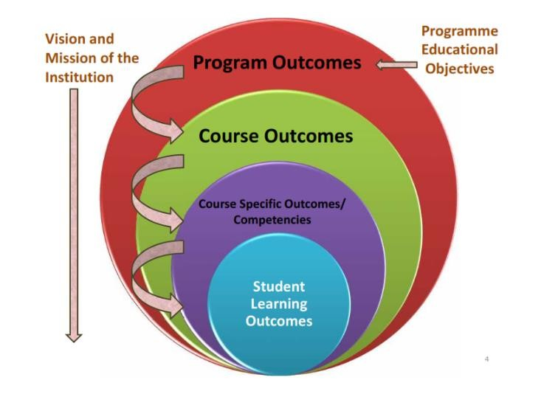
Program Outcomes
PO1: Engineering knowledge: Apply the knowledge of mathematics, science, engineering fundamentals, and an engineering specialization to the solution of complex engineering problems.
PO2:: Problem analysis: Identify, formulate, research literature, and analyze complex engineering problems reaching substantiated conclusions using first principles of mathematics, natural sciences, and engineering sciences.

Slide 4
Program Outcomes
PO3:: Design/development of solutions: Design solutions for complex engineering problems and design system components or processes that meet the specified needs with appropriate consideration for the public health and safety, and the cultural, societal, and environmental considerations.
PO4:: Conduct investigations of complex problems: Use research-based knowledge and research methods including design of experiments, analysis and interpretation of data, and synthesis of the information to provide valid
conclusions.
4

Slide 5
Program Outcomes
PO5:: Modern tool usage: Create, select, and apply appropriate techniques, resources, and modern engineering and IT tools including prediction and modeling to complex engineering activities with an understanding of the limitations.
PO6:: The engineer and society: Apply reasoning informed by the contextual knowledge to assess societal, health, safety, legal and cultural issues and the consequent responsibilities relevant to the professional engineering practice.
5
PO12: Life-long learning: Recognize the need for, and have the
preparation and ability to engage in independent and life-long learning in the
broadest context of technological change.

Slide 6
Program Specific Outcomes
PSO1:: Apply skills for configuring and operating complex software systems, packages, tools and applications for sustainability in various domains.
PSO2:: Acquire skills to model, design, develop, manage and resolve issues related to robust computing applications and software solutions
PSO3:: Able to practice and promote computing technologies for societal needs and
contribute to advancement of computer technology by means of research and development

Slide 7
Course Contents
Unit –I : Introduction to Django : Introduction to Django, Installing Python and Django, Setting up project in editor, Projects and Apps overview, Project structure, Creating your first project, Django-admin & manage.py commands, App structures, Creating an App
Unit –II : Views and URLs : Creating views and mapping to URLs, Creating views and view logic, HTTP requests, Creating Requests and Responses, Understanding URLs, Mapping URLs with Params, Regular expressions in URLs, Error Handling

Slide 8
Course Contents
Unit–III : Templates, Debugging and Testing : Introduction to Templates in Django, Creating Templates, Working with Django Template Language(DTL), Using template tags, Django variables, for loop and if-else statements, Dynamic Templates in Django, Working with Template inheritance, Debugging Django applications, Testing in Django
Unit –IV : Forms in Django : Introduction to Forms, Using GET, POST and HTTP, Building forms using Django, Introduction to Cross Site Request Forgery(CSRF), CSRF support in Django, Implementing POST redirect in Django, Data validation with Django forms

Slide 9
Course Contents
Unit–V : Models and Migrations and Django Admin : Creating models, Working with Migrations, Using the Django Shell to Explore Models(Insert, Update and Delete), Using Object Relational Mapping(ORM), Models using Foreign Keys, Django Admin, Adding groups and users, Users and Permissions, Database configuration – Configuring and setting up database connection
Unit–VI : Cookies and Sessions, users and authentication : Creating Cookies and sessions in Django, Creating and Managing Users in Django, Login and Logout URLs in Django, Using Django Login in Views

Slide 10
Course Contents
List of Practicals :
1. Set up a Django project, create an app, and execute basic manage.py commands.
2. Organize the project structure and explore the initial settings.
3. Develop views for different functionalities (e.g., displaying content, handling forms).
4. Map views to specific URLs and handle various HTTP requests.
5. Create and integrate templates in Django for different pages or components.
6. Debug a Django application, utilizing Django's built-in debugging features.
7. Implement basic tests to check functionality across different parts of the app.
8. Build forms using Django for user input or data submission.

Slide 11
Course Contents
List of Practicals (contd.) :
9. Validate form data and implement CSRF protection to ensure security.
10. Design and create models representing different data entities.
11.Apply migrations to reflect changes in the database schema.
12. Utilize Django Admin to manage and interact with model data.
13.Implement session-based functionality using cookies for user interaction.
14. Manage user creation, authentication, and permissions within the Django system.
15.Set up login/logout functionality and secure specific views with authentication checks.

Slide 12
Course Assessment Model
Marks break up*
Attendance
CA
ETP
5
45
50
100
Total
CA | Allocation week | Submission week
Test1 | 3rd | 5th
Test2 | 8th | 10th
Project(live Django Web app) | 4th | 12th
CA category: A0203(Best 2 out of 3)

Slide 13
Learning Resources
Text Books:
1. BUILDING WEBSITES WITH DJANGO by AWANISH RANJAN, BPB PUBLICATIONS
References:
1. DESIGNING MICROSERVICES USING DJANGO by SHAYANK JAIN, BPB PUBLICATIONS

Slide 14
Course Focus
One of the most in-demand skills for Python-based web development roles in the industry.
Django is used by well-known, large-scale platforms for building robust web applications.
Widely adopted by IT services and product companies for backend and full-stack development
A strong foundation for careers as a Python Developer, Django Developer, or Backend Engineer.

Slide 15
Relevancy of Django for Placements
Django system is one of the most important topics for Placement preparation.
The following are the most important topics to focus upon:
Django ORM and Models
Views and URL Routing
Templates and DTL
Forms and CSRF Protection
Migrations and Database Design
Authentication and Sessions
MVT Architecture

Slide 16
Importance of the course
Many recruiters (like TCS, CTS, HCL, IBM, Tech Mahindra, Amdocs, etc.) ask about Django and web development in the Technical Quiz and Technical Interview round.
This course is essential for aspiring web developers, since Django is one of the most widely used Python frameworks for building scalable, production-grade web applications in the industry.

Slide 17
Skill Attainment
Develop proficiency in Django project setup, app structuring, and the MVT architecture.
Apply views, URL routing, templates, and Django's Template Language techniques.
Use Django forms, CSRF protection, and data validation for secure user input handling.
Analyze and build data models, migrations, and ORM-based database interactions.
Build industry-relevant competencies for Web Development, Backend Engineering, and Full-Stack Python roles.

Slide 18


EDUCATION REVOLUTION @
“…Gamified Learning”

Slide 19

Recognition of Prior Learning (RPL)
Process of extending course exemptions to students on the basis of prior knowledge attained by student through
•Experience/ Training
•Certification
•Internship/ Apprenticeship etc. (Exam Based Exemption)

Slide 20
Upto 10 % Attendance Benefit
1. The 10% Attendance Benefit allows eligible students to receive up to a 10% relaxation in attendance requirements for approved academic, or professional
accomplishments.
2. Minimum 7.5 CGPA (by end of term) is mandatory
3. Students must maintain a minimum of 60% attendance without any bonus/Duty leave by the end of the term
4. The student must have no record of indiscipline to be eligible for this benefit.
5. Benefit shall be finally granted only upon the final approval of the Standing Committee after verification of submitted documents & progress of the student.
6. Attendance related benefits must be used for academic purposes that can enhance your learning, skill development and overall academic progression.

Slide 21
Duty Leave (DL) under EDU Revolution
1. Duty Leave (DL) refers to the formal approval granted to students for participation in recognized academic, co-curricular, or professional activities conducted during class time.
2.Students must maintain a minimum of 60 % attendance without any bonus/Duty Leave
3. The student must have no record of indiscipline to be eligible for Duty Leave
4. All submitted documents will undergo verification, and Duty Leave shall be granted only upon the final approval of the Standing Committee.

Slide 22
Grade Upgradation
1. Grade Upgradation is an academic benefit that enhances a student’s course grade based on eligible academic, research, or co-curricular
accomplishments.
2. No minimum CGPA requirement is applicable for availing the grade-up benefits
3. Grade upgrade benefits must be claimed before programme completion and before the final mark sheet is issued
4. All benefits listed are subject to approval and may be revised at any time. Students may submit nominations for consideration; however, no benefit
can be claimed as a matter of right
5. The benefits will be given in the mapped course only as recommended by the standing committee.
6. Academic benefits will be granted in a sequential manner, based on the stage achieved by the student. If a student has already availed the Stage-1
benefit, he/she will be eligible only for the proportionate Stage-2 benefit

Slide 23
Interfaces and Contact Information
UMS link to apply for EDU Revolution initiatives:
UMS Navigation --- LMS → EDU Revolution: BE THE CHANGE
In case of any query in this regard the student can approach for resolution through RMS at the following path:
UMS Navigation--- Relationship management system → EDU Revolution: BE THE CHANGE
OR get your queries resolved through the Helpline Number: 01824-520150.

